Slide 1
T20 Analysis
Kaushik​

Slide 2


Contents
T20
Problem Statement
Requirement Scoping
Data Collection, Cleaning and Transformation
Data Modeling and DAX Measures
Dashboard

Slide 3
Problem Statement
A much needed cricket team has to made
for an important match(Humans vs Alieans) to be played.
The team should contains some strong players with outstanding
Stats which statisfy the given conditions.

Slide 4
Requirement Scoping

Slide 5
PARAMETERS | DESCRIPTION | CRITERIA
Batting Average | Average runs scored in an innings | >30
Strike Rate | No of runs scored per 100 balls | > 140
Innings Batted | Total Innings batted | > 3
Boundary % | % of runs scored in boundaries | > 50
Batting Position | Order in which the batter played | <4
OPENERS
PARAMETERS | DESCRIPTION | CRITERIA
Batting Average | Average runs scored in an innings | >40
Strike Rate | No of runs scored per 100 balls | > 125
Innings Batted | Total Innings batted | > 3
Boundary % | % of runs scored in boundaries | > 20
Batting Position | Order in which the batter played | >2
ANCHORS / MIDDLE ORDER

Slide 6
Parameters | Description | Criteria
Batting Average | Average runs scored in an innings | > 25
Strike Rate | No of runs scored per 100 balls | > 130
Innings Batted | Total Innings batted | > 3
Avg. Balls Faced | Average balls faced by the batter in an innings | > 12
Batting Position | Order in which the batter played | > 4
Innings Bowled | Total Innings Bowled by the bowler | > 1
FINISHER / LOWER ORDER ANCHOR
Parameters | Description | Criteria
Batting Average | Average runs scored in an innings | > 15
Strike Rate | No of runs scored per 100 balls | > 140
Innings Batted | Total Innings batted | > 2
Batting Position | Order in which the batter played | > 4
Innings Bowled | Total Innings bowled | >2
Bowling Economy | Average runs allowed per over | < 7
Bowling Strike Rate | Average no. of balls required to take a wicket | <20
ALL-ROUNDERS / LOWER ORDER

Slide 7
SPECIALIST FAST BOWLERS
Parameters | Description | Criteria
Innings Bowled | Total Innings bowled | > 4
Bowling Economy | Average runs allowed per over | < 7
Bowling Strike Rate | Average no. of balls required to take a wicket | < 16
Bowling Style | Bowling style of the player | = "%Fast%"
Bowling Average | No. of runs allowed per wicket | < 20
Dot Ball % | % of dot balls bowled | > 40

Slide 8
Data Collection
The data required was being extracted or web scraped from ESPN (ICC T20 World Cup) sports website.
Contents like players, match summary, batting summary, bowler summary.
Data Cleaning
The data extracted was manipulated (like removing null values, creating new columns as required, etc.) and made appropriate.
The data cleaning was done by pandas libraries in Jupiter notebook (python).
Data Transformation
After data cleaning the data sets are transferred to Tableau, and furthermore the data sets are manipulated in which calculated parameters are created.
Also required measure fields are created.

Slide 9
Data Sets

Slide 10
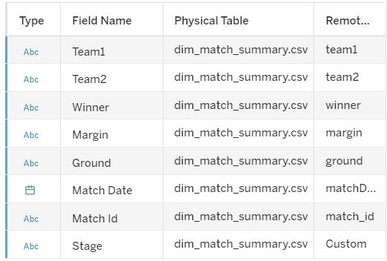
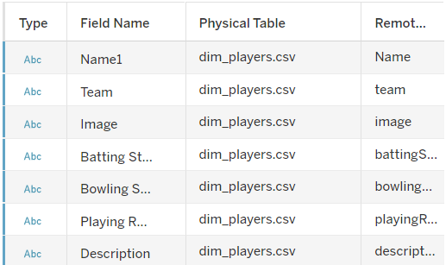
Match_Summary
Player_Summary

Slide 11
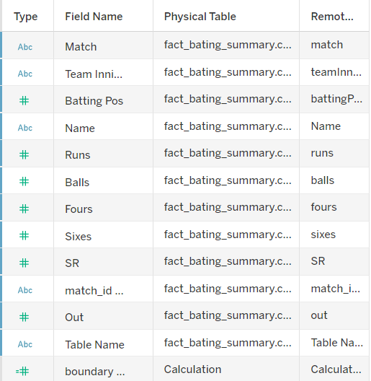
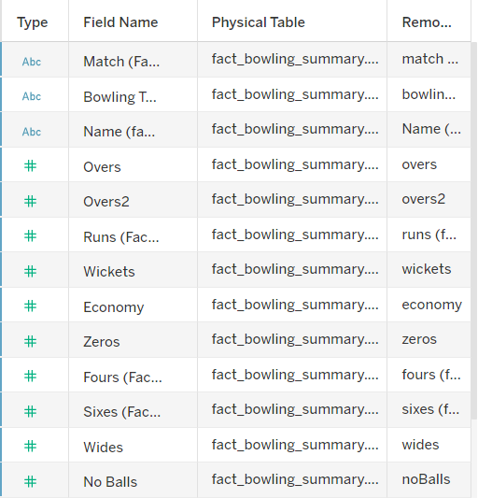
Match_Summary
Match_Summary

Slide 12
Calculated Field Formulae

Slide 13
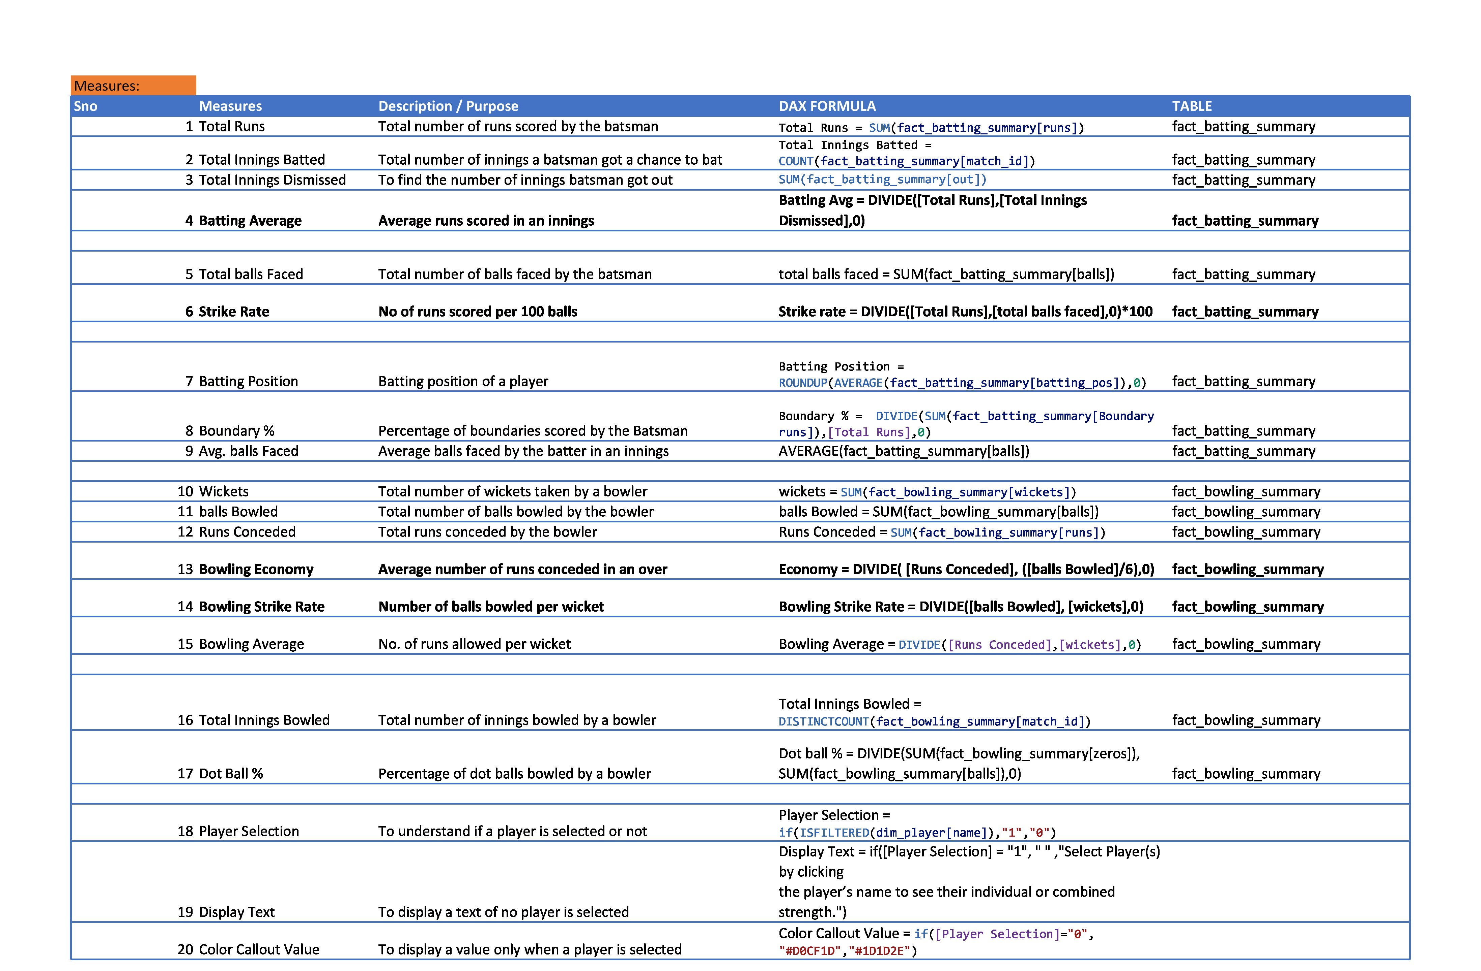

Slide 14
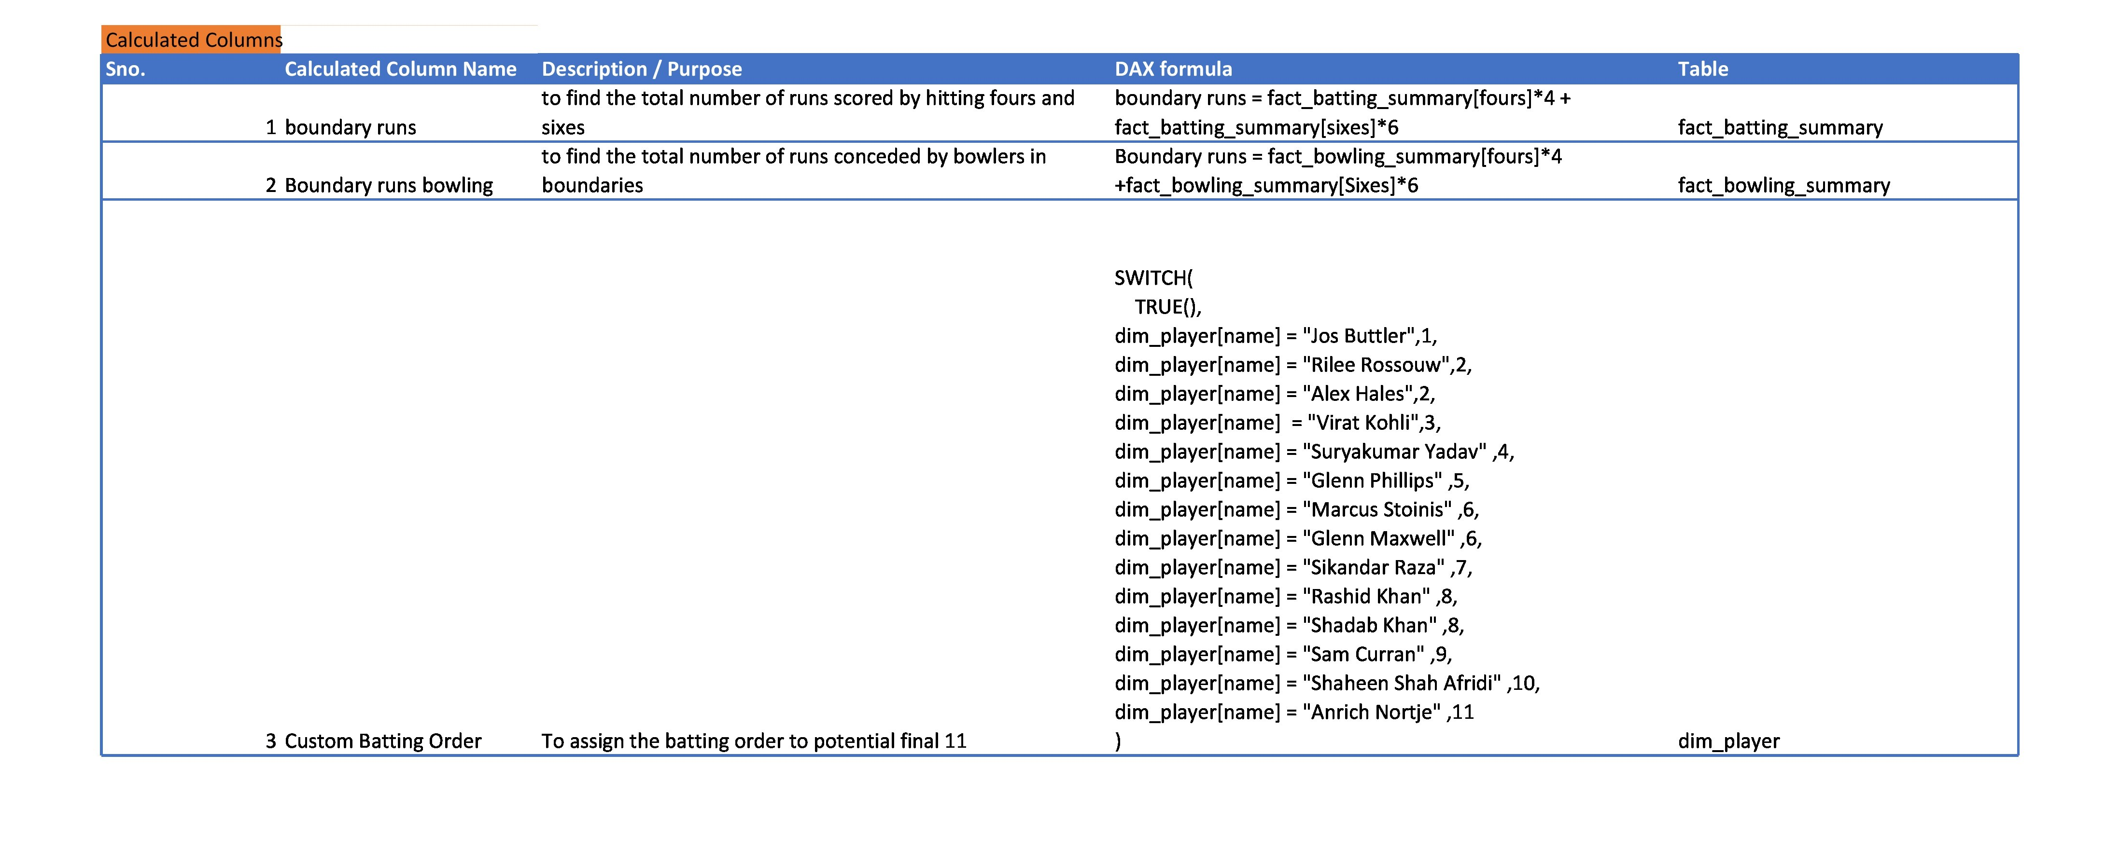

Slide 15
Realtional Tree

Slide 16
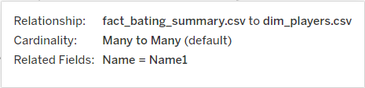
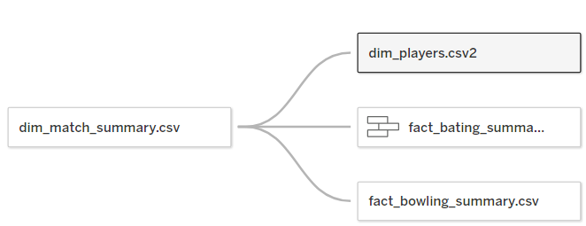
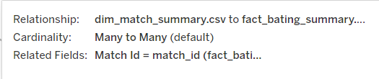
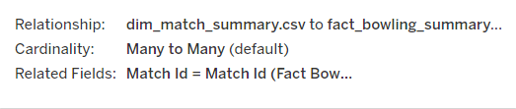

Slide 17
Dashboard

Slide 18
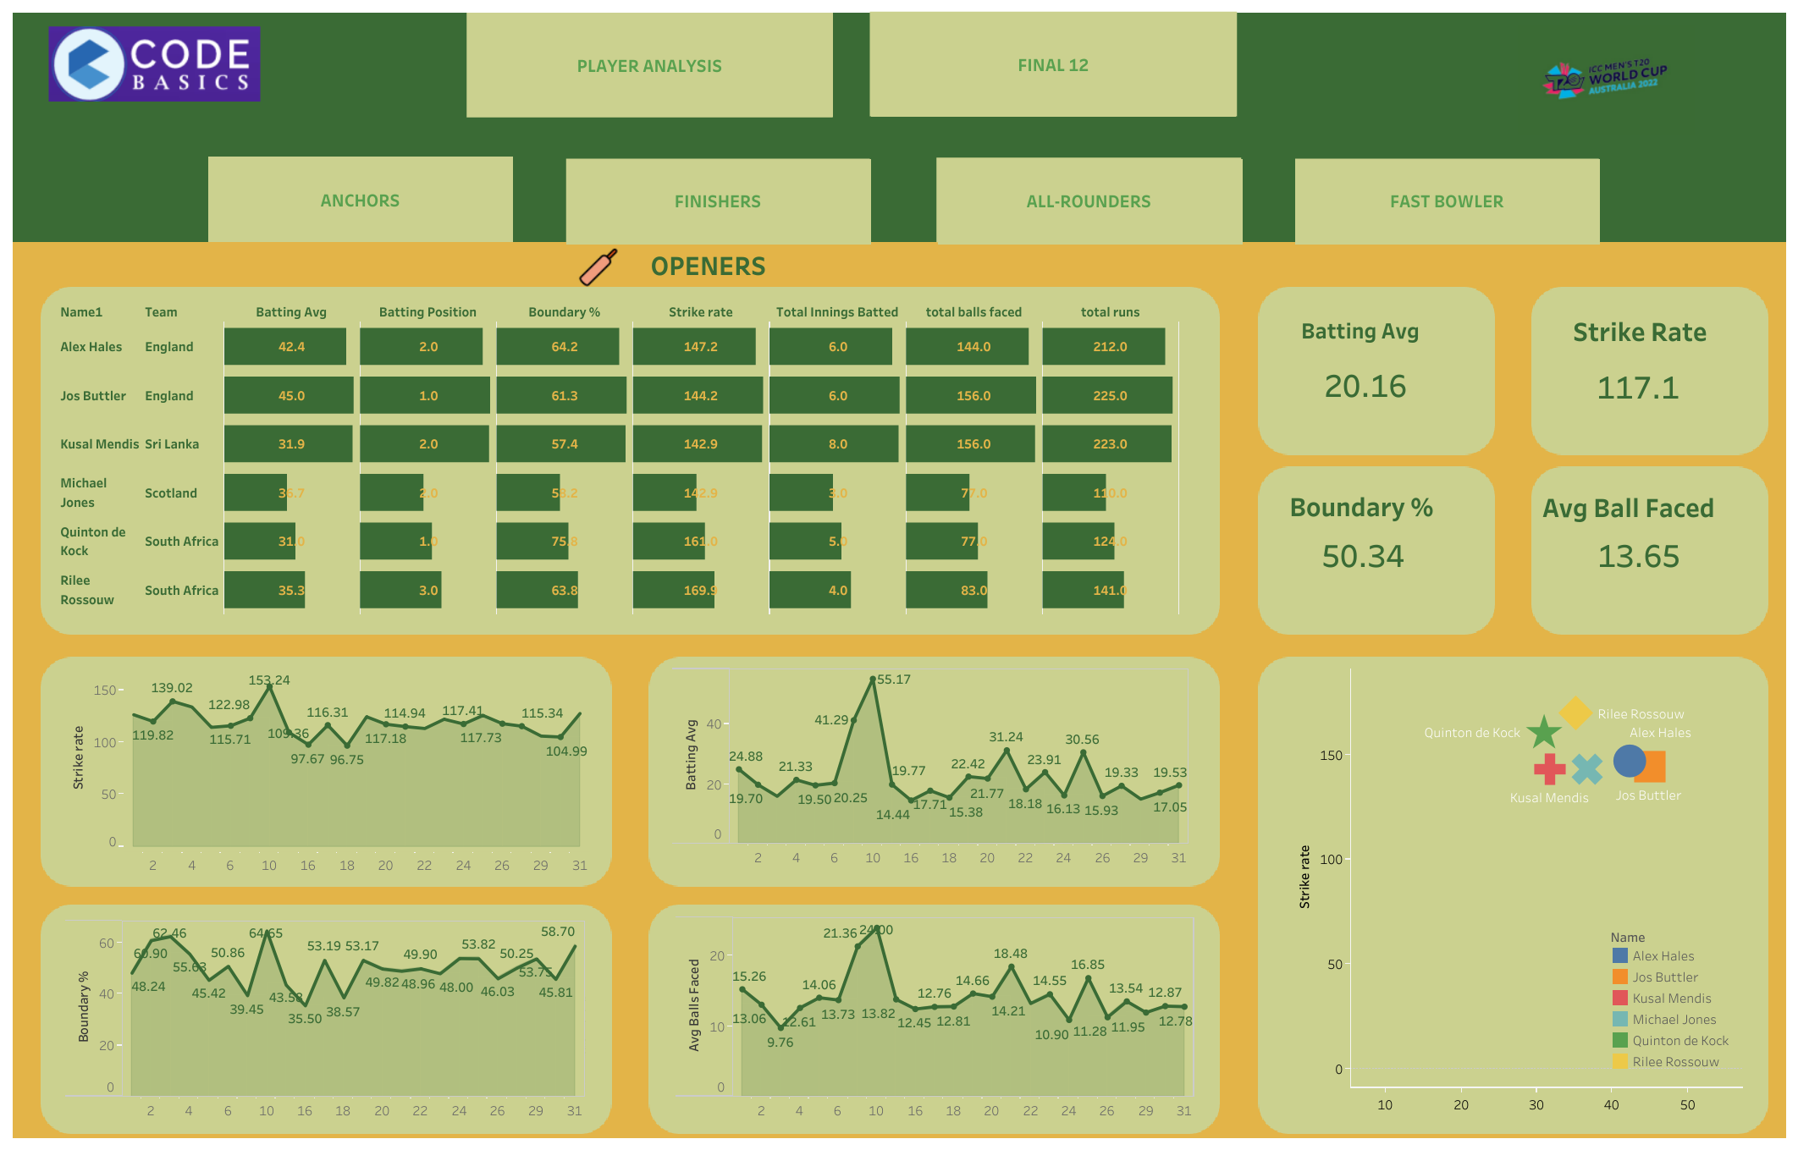

Slide 19
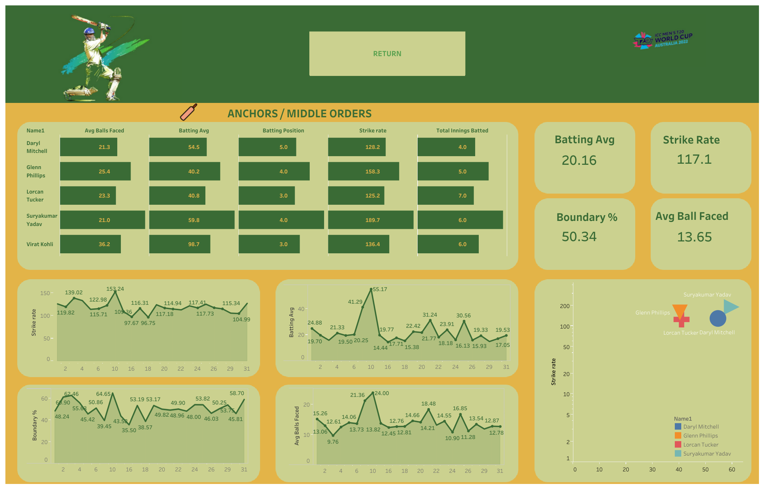

Slide 20
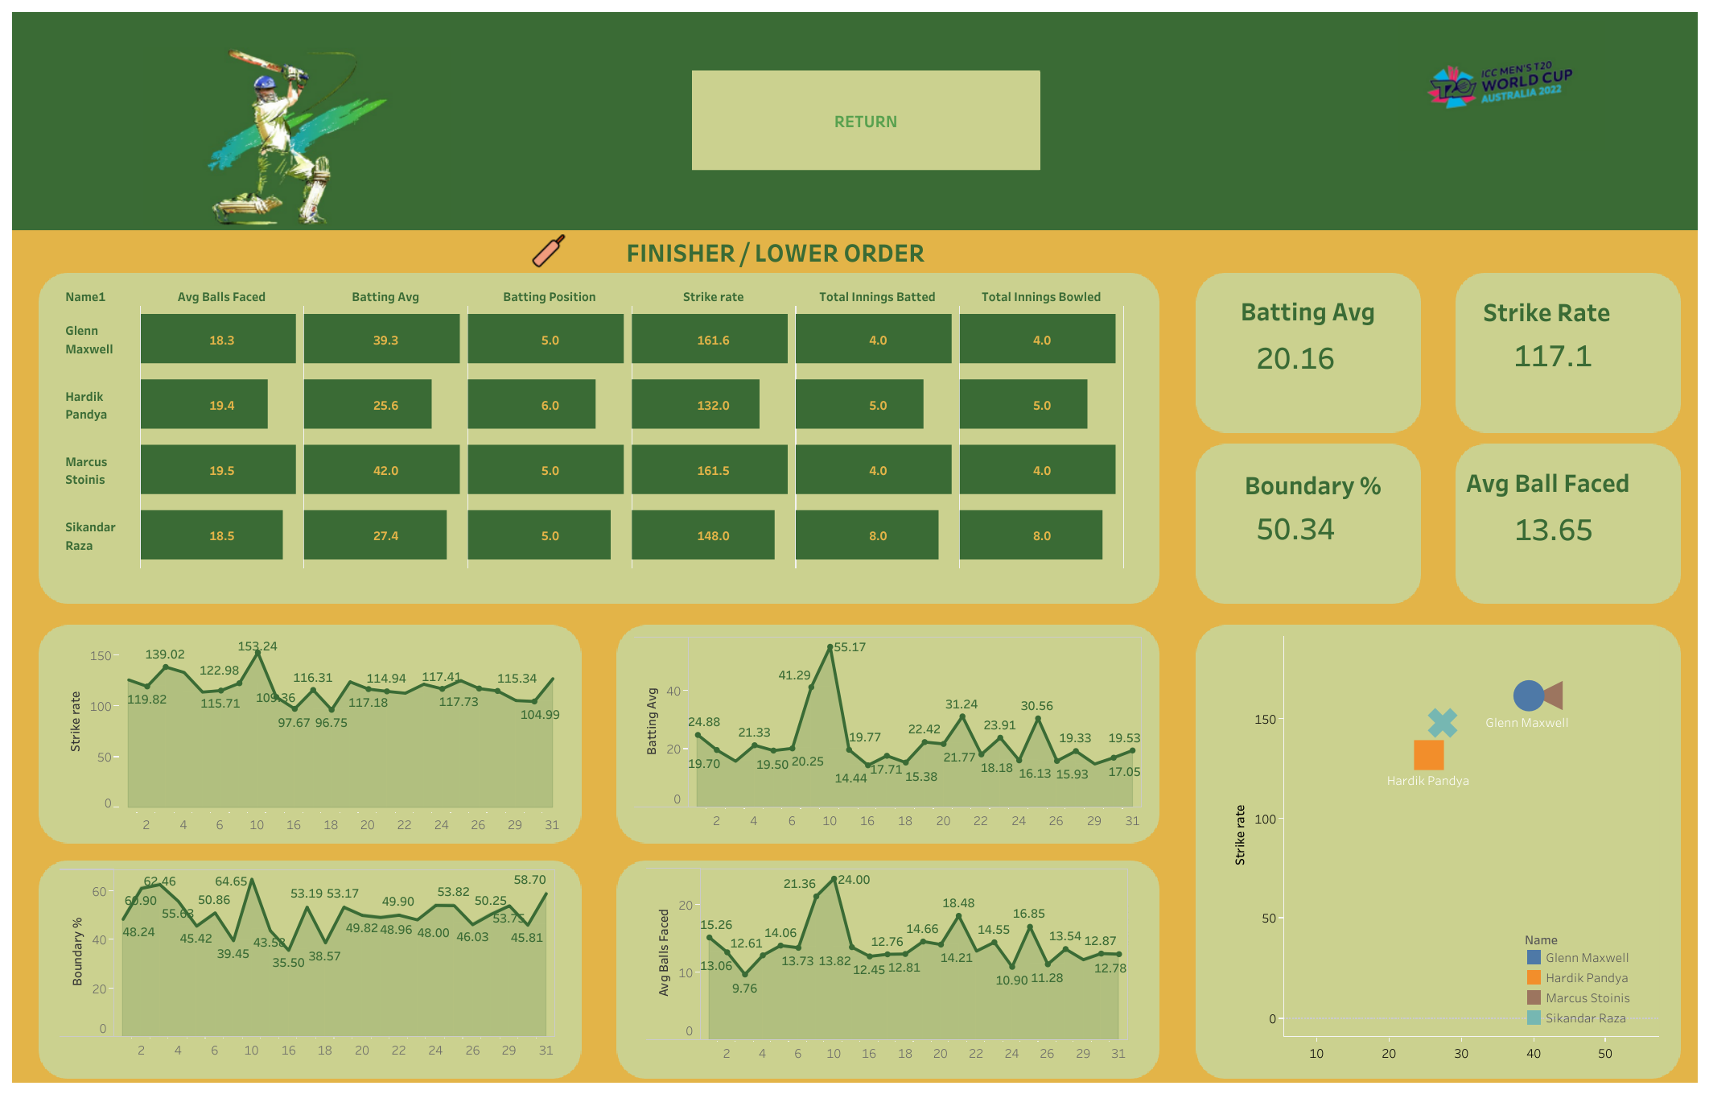

Slide 21
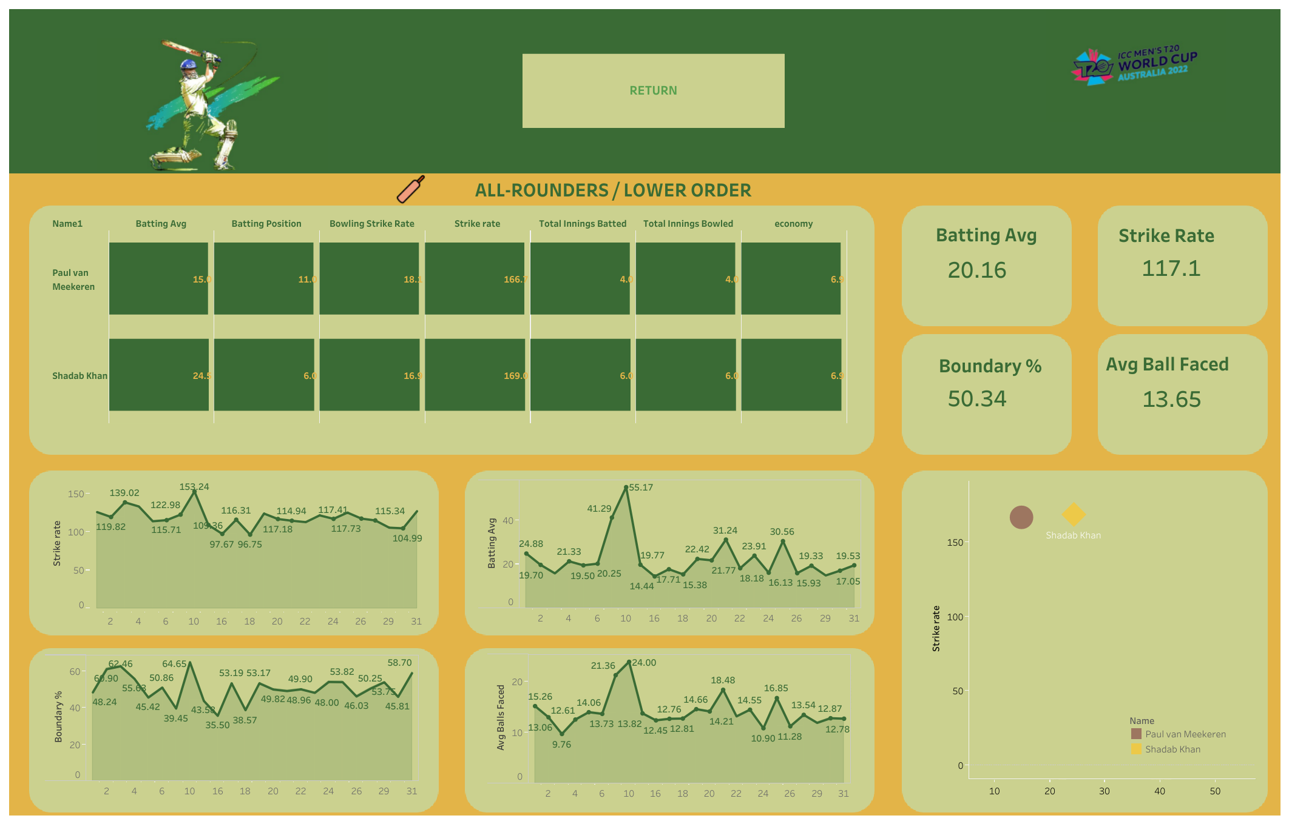

Slide 22
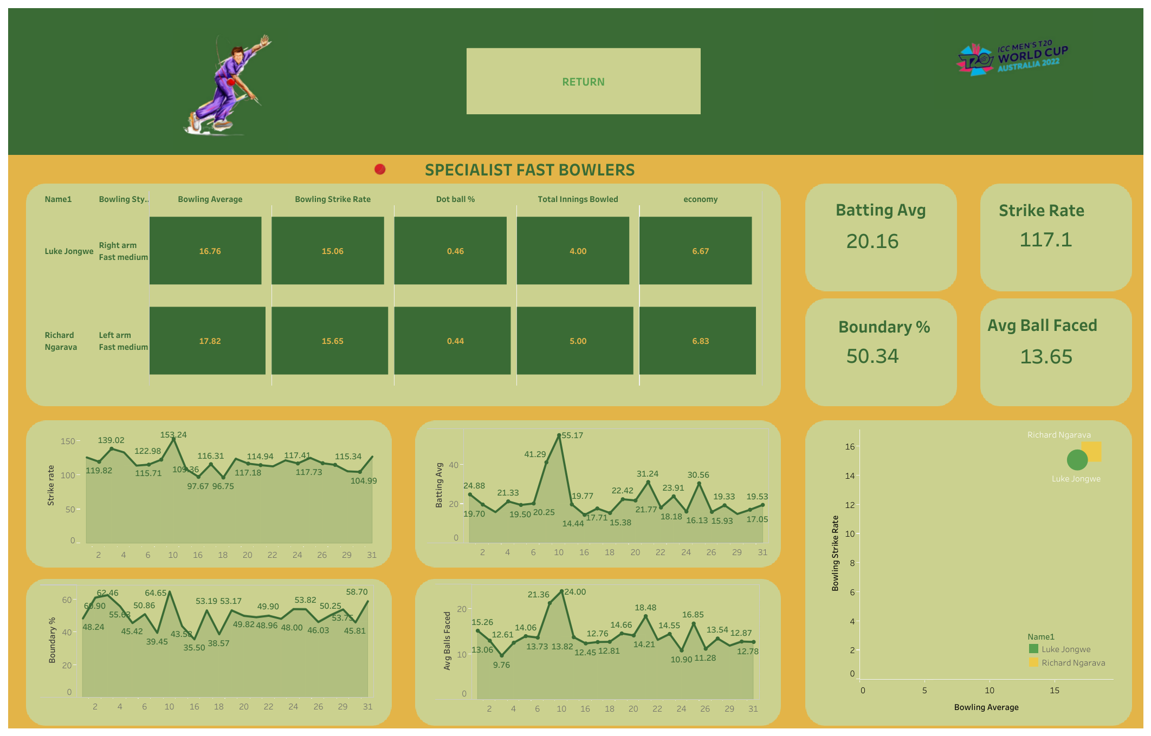

Slide 23
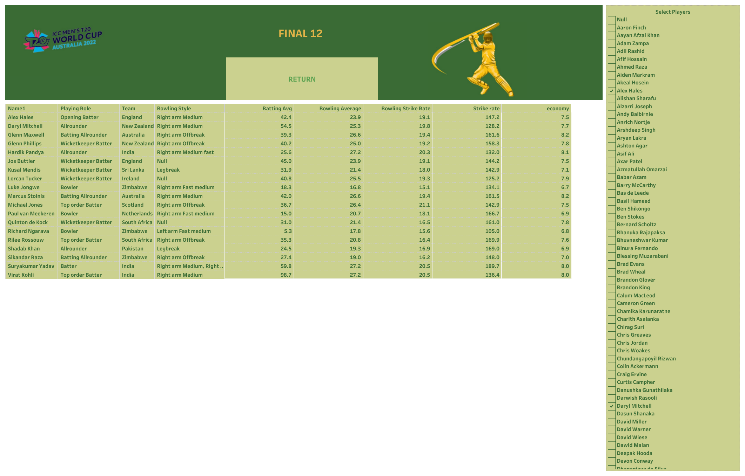

Slide 24
Summary
By this dashboard we can filter the most wanted players according to their stats in Super 12 dashboard.
And according to given requirement we can observe each individual player performance in respective dashboards.
Therefore now we can assign a most wanted 11 players to the most important match

Slide 25
Thank you
Kaushik​
srinukaus@gmail.com

